Slide 1


Calculus and applications
MTH10012
Week 9

Slide 2
Introduction
Week 8
Integration of products of trig/hyp functions
Method of partial fractions, trigonometric and hyperbolic substitutions
Integration by parts
Week 9
TEST 2
MODULE 5
Definite integration and a version of the Fundamental Theorem of Calculus
Areas between two curves and arc lengths
(In week 10)
MODULE 6
Differential equations: definition, classification, solutions
Elementary and separable first order ODEs and initial value problems

Slide 3
5.8 The definite integral
Eudoxus (c.408-355 BC) and Archimedes (c.285-212 BC) use the method of exhaustion to compute the area of a circle.
…

Slide 4
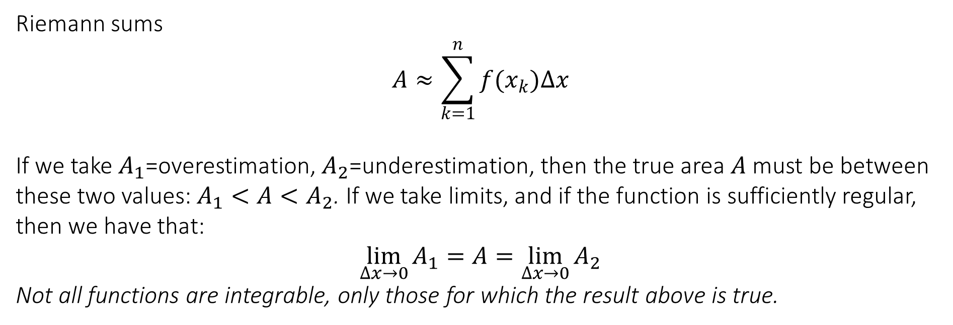
5.8 The definite integral
The problem of finding the area below a curve began with Cavalieri (1630s), who developed the idea of indivisibles.
https://www.geogebra.org/m/Fv6t696j
Riemann sums
$$A≈\sum_{k=1}^{n}{f(x_{k})∆x}$$
If we take $A_{1}$=overestimation, $A_{2}$=underestimation, then the true area $A$ must be between these two values: $A_{1}<A<A_{2}$. If we take limits, and if the function is sufficiently regular, then we have that:
$$\lim_{∆x→0}{A_{1}}=A=\lim_{∆x→0}{A_{2}}$$
Not all functions are integrable, only those for which the result above is true.

Slide 5
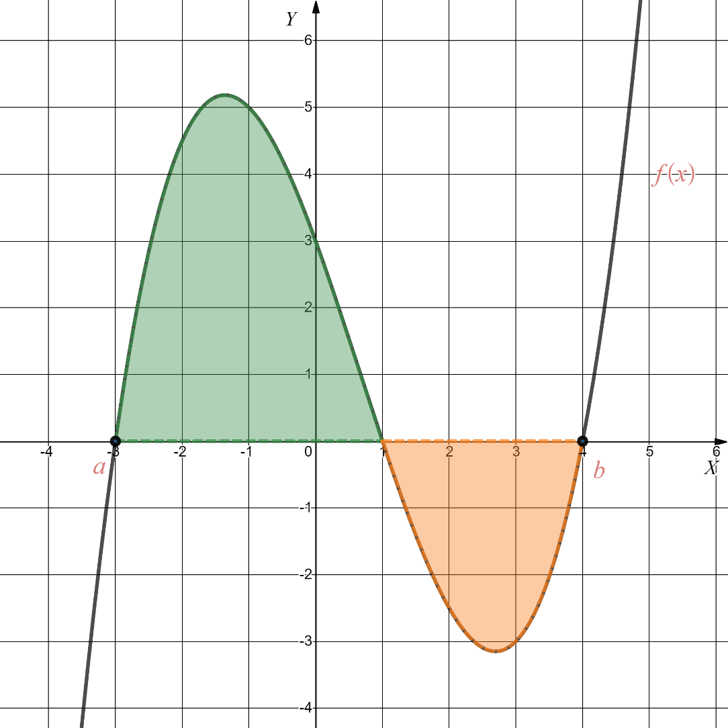
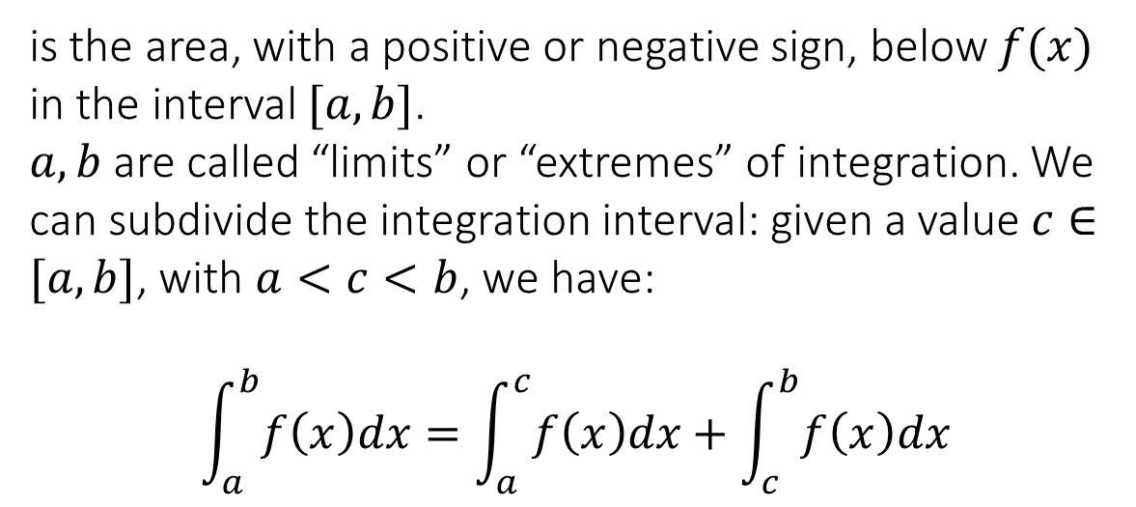
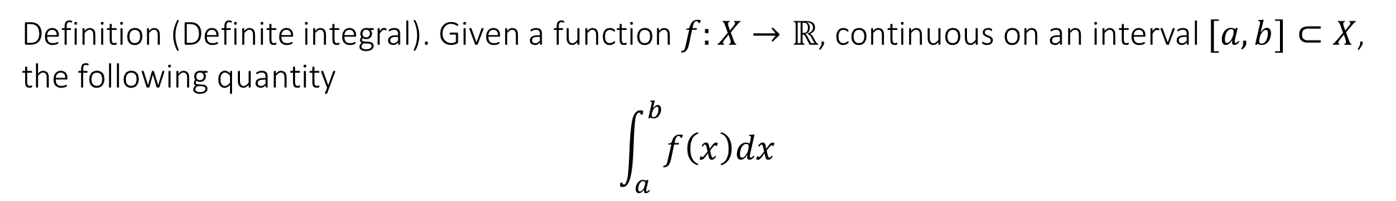
5.8 The definite integral
Definition (Definite integral). Given a function $f:X→ℝ$, continuous on an interval $[a,b]⊂X$, the following quantity
$$\int_{a}^{b}{f\left(x\right)dx}$$
is the area, with a positive or negative sign, below $f(x)$ in the interval $[a,b]$.
$a,b$ are called “limits” or “extremes” of integration. We can subdivide the integration interval: given a value $c∈[a,b]$, with $a<c<b$, we have:
$$\int_{a}^{b}{f\left(x\right)dx}=\int_{a}^{c}{f\left(x\right)dx}+\int_{c}^{b}{f\left(x\right)dx}$$

Slide 6
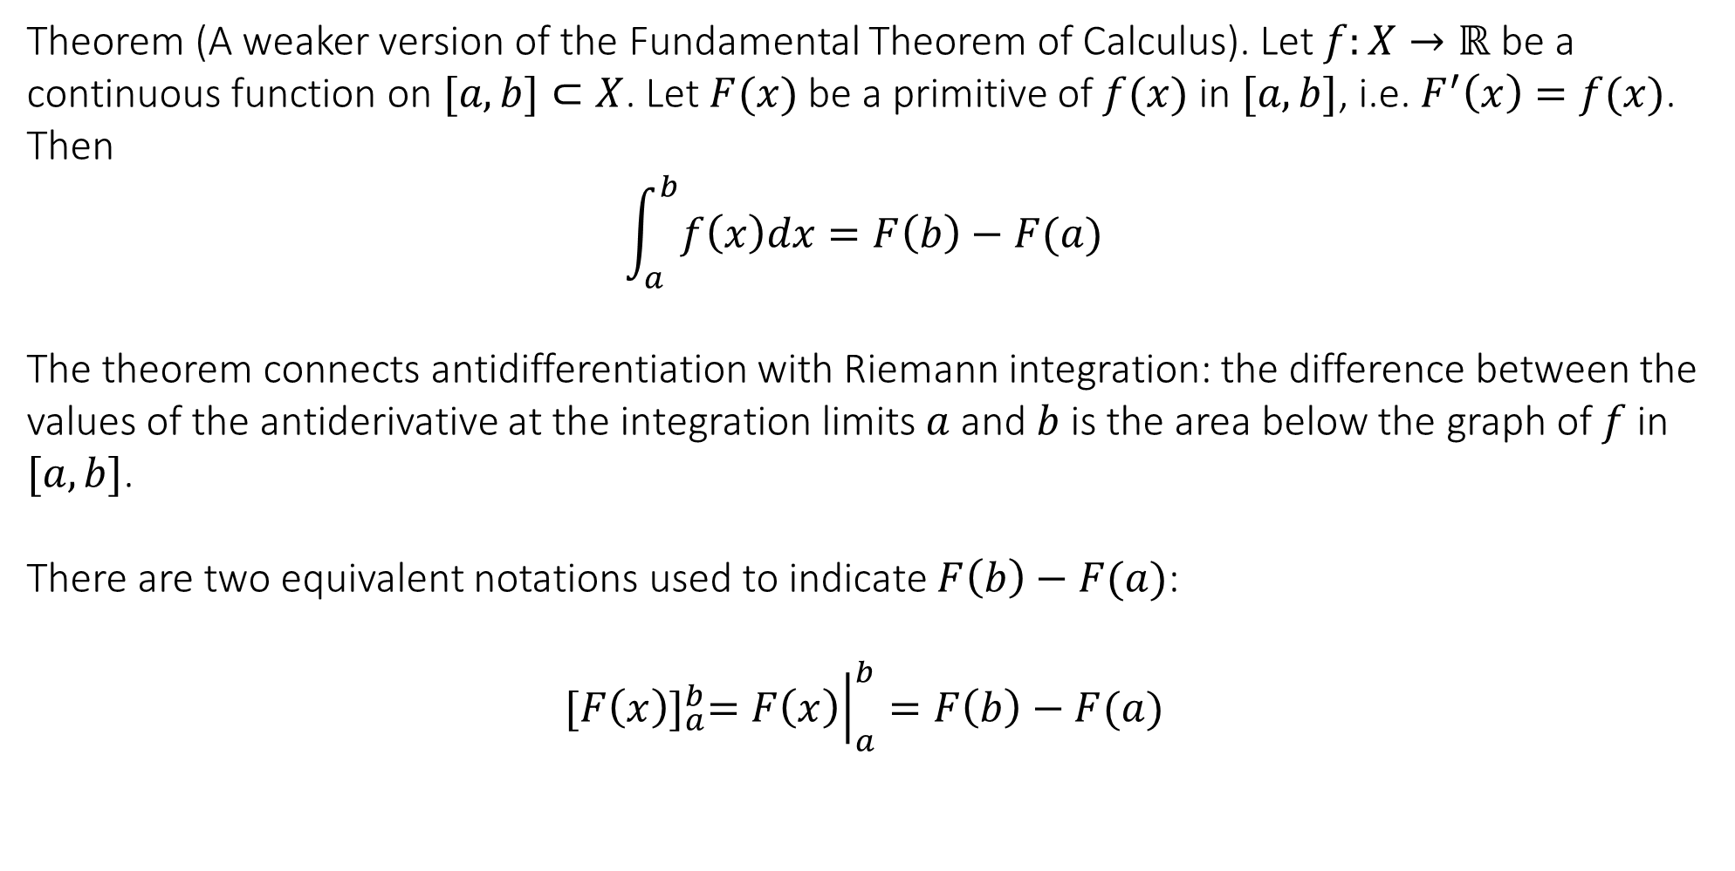
5.8 The definite integral
Theorem (A weaker version of the Fundamental Theorem of Calculus). Let $f:X→ℝ$ be a continuous function on $[a,b]⊂X$. Let $F(x)$ be a primitive of $f(x)$ in $[a,b]$, i.e. $F^{′}\left(x\right)=f(x)$. Then
$$\int_{a}^{b}{f\left(x\right)dx}=F\left(b\right)−F(a)$$
The theorem connects antidifferentiation with Riemann integration: the difference between the values of the antiderivative at the integration limits $a$and $b$is the area below the graph of $f$ in $[a,b]$.
There are two equivalent notations used to indicate $F\left(b\right)−F(a)$:
$${[F\left(x\right)]}_{a}^{b}={\left.F\left(x\right)\right|}_{a}^{b}=F\left(b\right)−F(a)$$

Slide 7
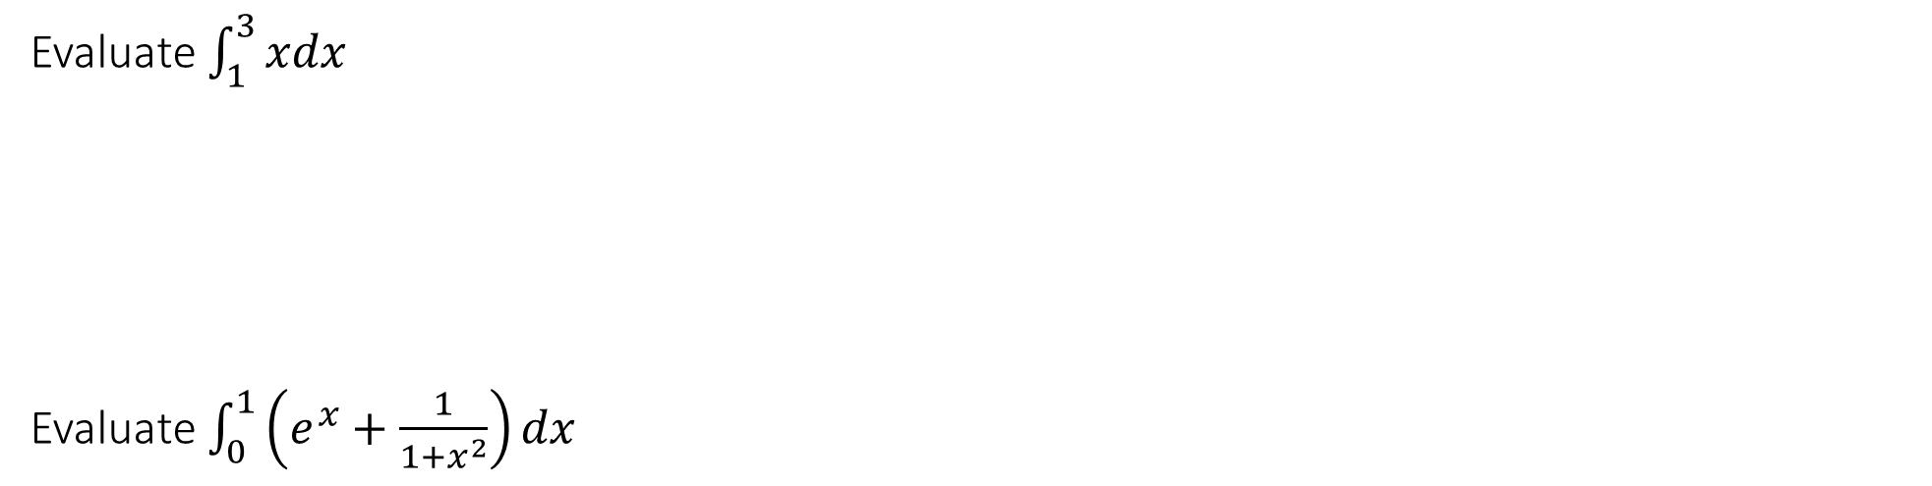
5.8 The definite integral
Evaluate $\int_{1}^{3}{xdx}$
Evaluate $\int_{0}^{1}{\left(e^{x}+\frac{1}{1+x^{2}}\right)dx}$

Slide 8
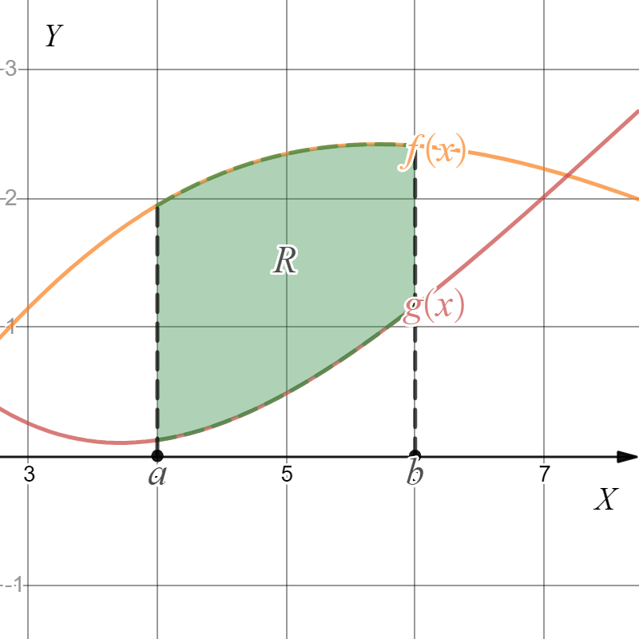
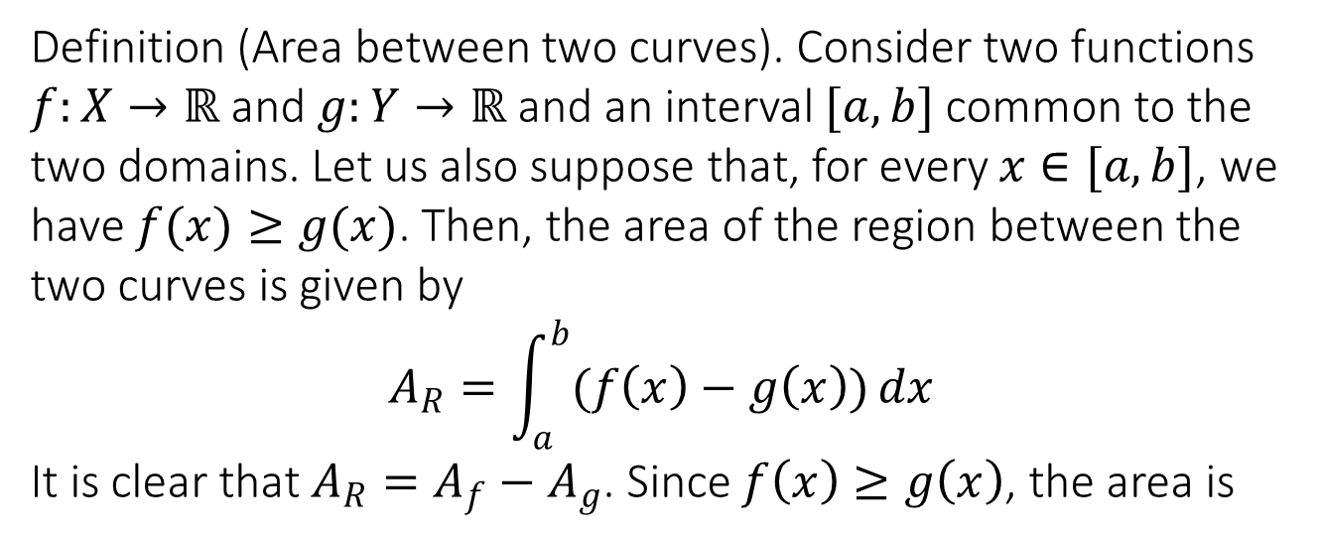
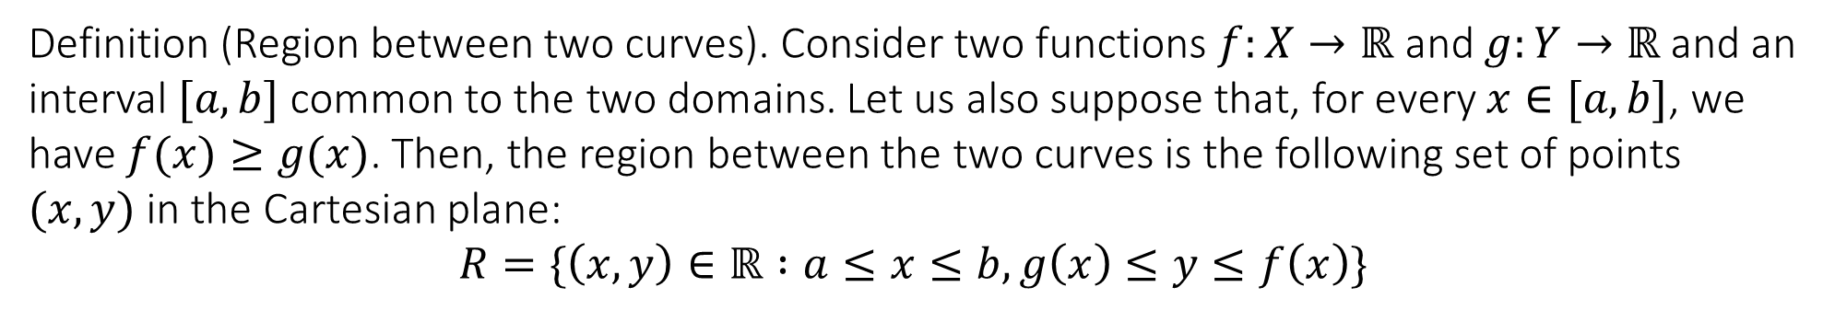
5.9 Applications: areas between two curves and arc lengths
Definition (Region between two curves). Consider two functions $f:X→ℝ$ and $g:Y→ℝ$ and an interval $[a,b]$ common to the two domains. Let us also suppose that, for every $x∈[a,b]$, we have $f(x)≥g(x)$. Then, the region between the two curves is the following set of points $(x,y)$ in the Cartesian plane:
$$R=\{\left(x,y\right)∈ℝ :a≤x≤b, g\left(x\right)≤y≤f\left(x\right)\}$$
Definition (Area between two curves). Consider two functions $f:X→ℝ$ and $g:Y→ℝ$ and an interval $[a,b]$ common to the two domains. Let us also suppose that, for every $x∈[a,b]$, we have $f(x)≥g(x)$. Then, the area of the region between the two curves is given by
$$A_{R}=\int_{a}^{b}{(f\left(x\right)−g\left(x\right))}dx$$
It is clear that $A_{R}=A_{f}−A_{g}$. Since $f\left(x\right)≥g\left(x\right)$, the area is
positive.

Slide 9
5.9 Applications: areas between two curves and arc lengths
Find the area of the region bounded by the graphs of $f\left(x\right)=−x+3$ and $g\left(x\right)={\left(x−1\right)}^{2}$.

Slide 10
5.9 Applications: areas between two curves and arc lengths
Find the area of the region bounded by the graphs of the Y-axis, $f\left(x\right)=x^{3}+1$ and $g\left(x\right)=−x^{2}+3$.

Slide 11
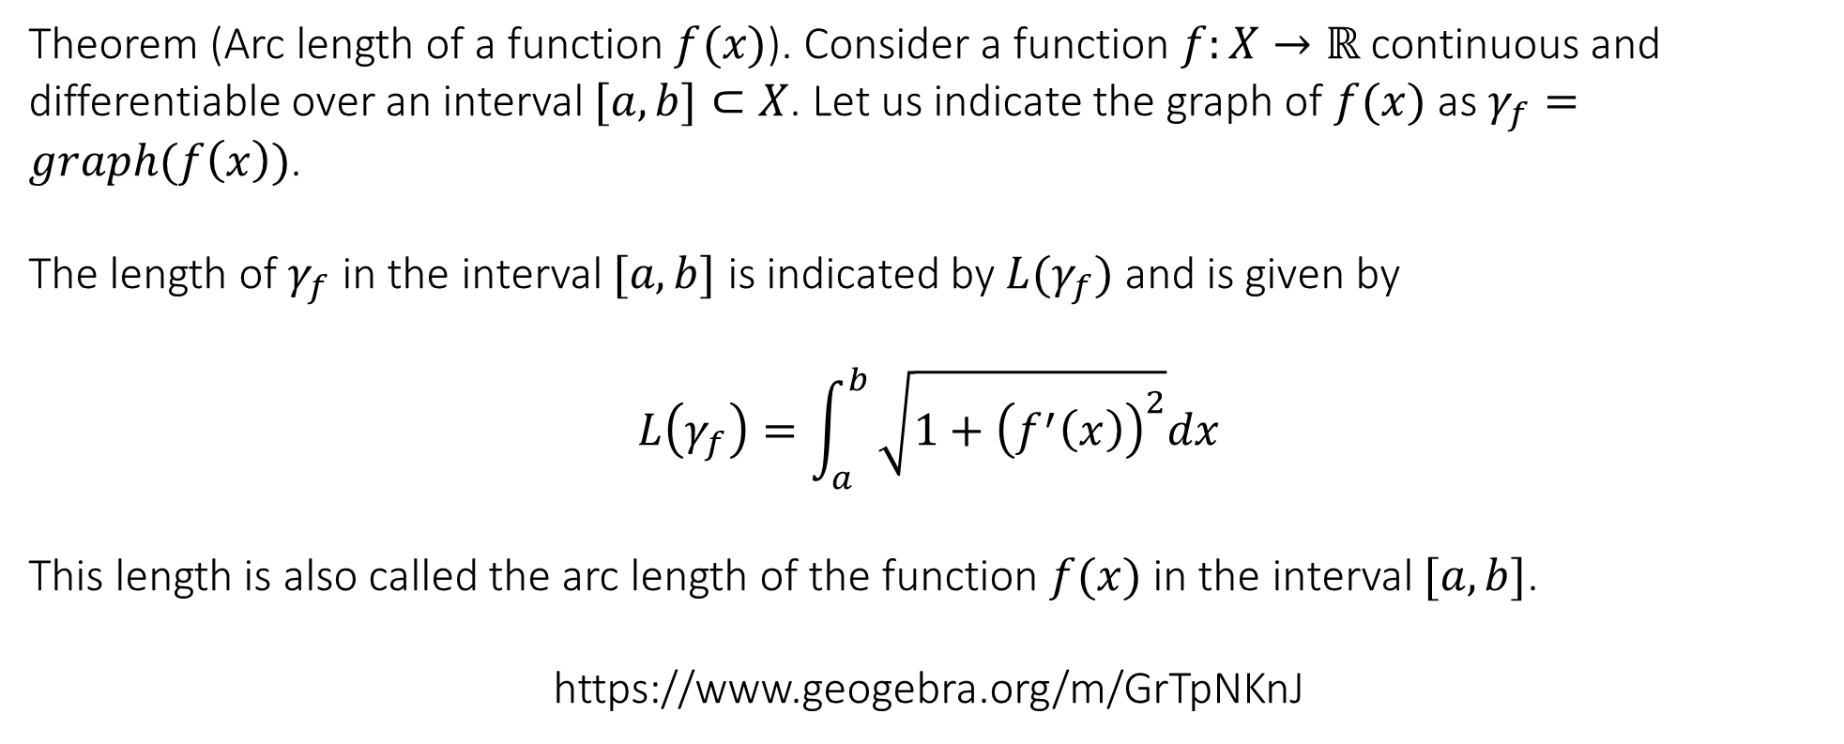
5.9 Applications: areas between two curves and arc lengths
Arc length of a curve
Theorem (Arc length of a function $f(x)$). Consider a function $f:X→ℝ$ continuous and differentiable over an interval $[a,b]⊂X$. Let us indicate the graph of $f(x)$ as $γ_{f}=graph(f\left(x\right))$.
The length of $γ_{f}$ in the interval $[a,b]$ is indicated by $L(γ_{f})$ and is given by
$$L\left(γ_{f}\right)=\int_{a}^{b}{\sqrt{1+{\left(f^{′}\left(x\right)\right)}^{2}}dx}$$
This length is also called the arc length of the function $f(x)$ in the interval $[a,b]$.
https://www.geogebra.org/m/GrTpNKnJ

Slide 12
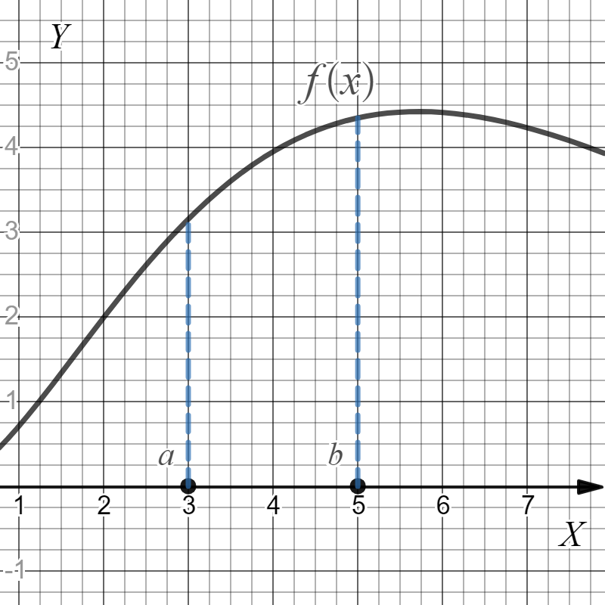
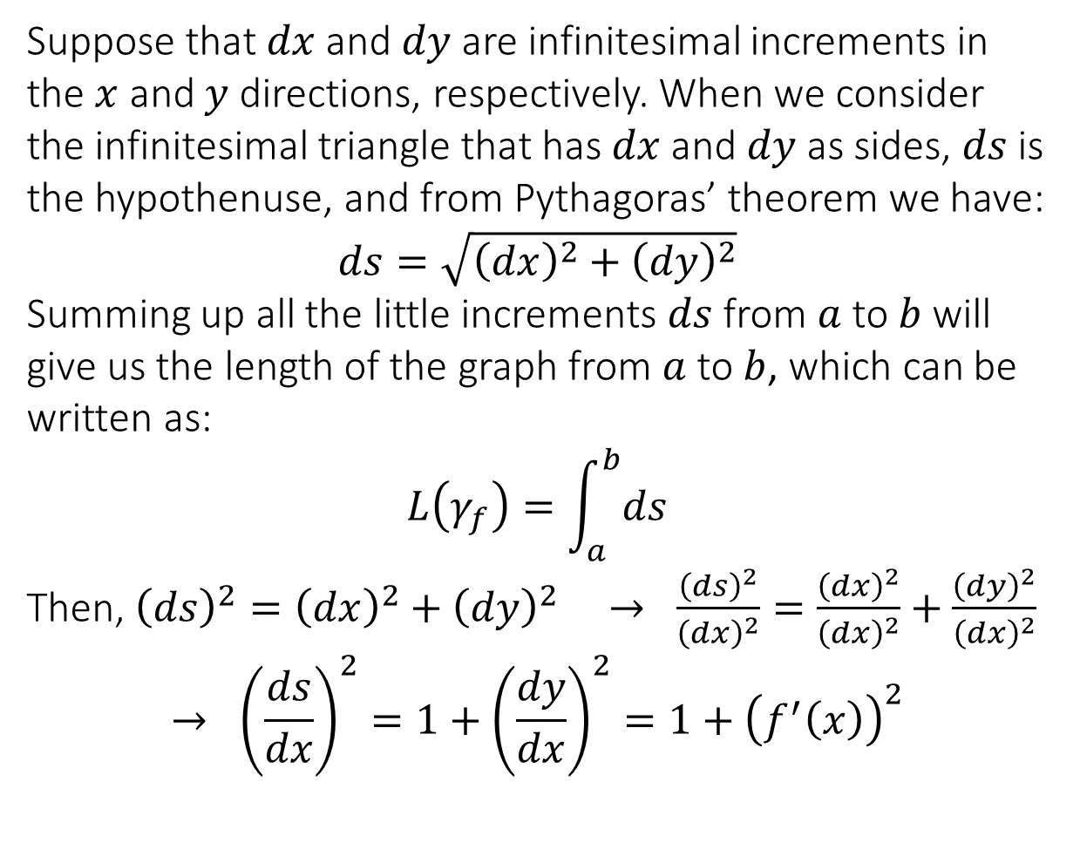



5.9 Applications: areas between two curves and arc lengths
Suppose that $dx$ and $dy$ are infinitesimal increments in the $x$ and $y$ directions, respectively. When we consider the infinitesimal triangle that has $dx$ and $dy$ as sides, $ds$ is the hypothenuse, and from Pythagoras’ theorem we have:
$$ds=\sqrt{{\left(dx\right)}^{2}+{\left(dy\right)}^{2}}$$
Summing up all the little increments $ds$ from $a$ to $b$ will give us the length of the graph from $a$ to $b$, which can be written as:
$$L\left(γ_{f}\right)=\int_{a}^{b}{ds}$$
Then, ${\left(ds\right)}^{2}={\left(dx\right)}^{2}+{\left(dy\right)}^{2} → \frac{{\left(ds\right)}^{2}}{{\left(dx\right)}^{2}}=\frac{{\left(dx\right)}^{2}}{{\left(dx\right)}^{2}}+\frac{{\left(dy\right)}^{2}}{{\left(dx\right)}^{2}}$
$$→ {\left(\frac{ds}{dx}\right)}^{2}=1+{\left(\frac{dy}{dx}\right)}^{2}=1+{\left(f^{′}\left(x\right)\right)}^{2}$$
$$ds$$
$$dy$$
$$dx$$

Slide 13
5.9 Applications: areas between two curves and arc lengths
Find the length of the curve for $f\left(x\right)=\frac{2}{3}x^{\frac{3}{2}}$ between $x=0$ and $x=1$.

Slide 14
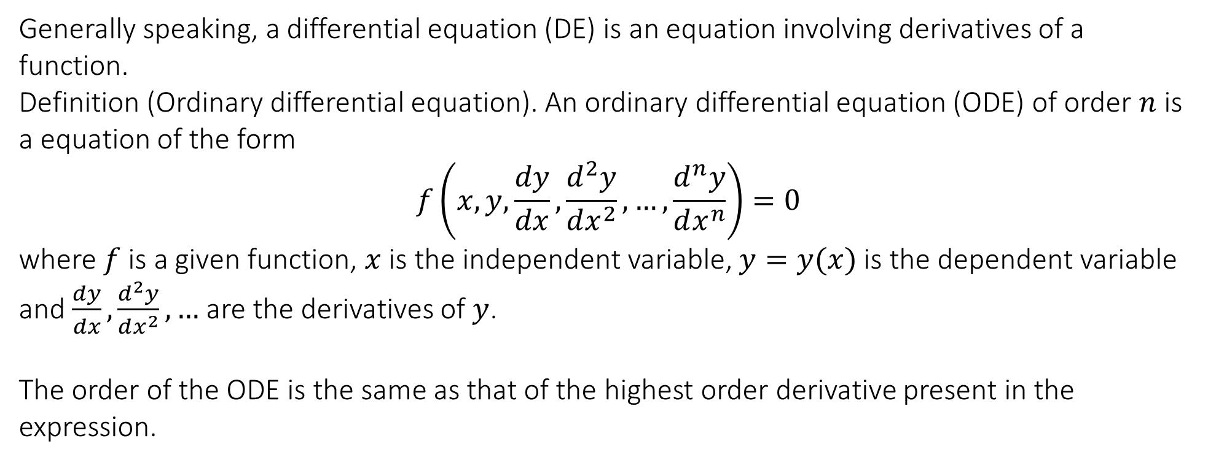
6.1 Differential Equations: definition, classification and solutions
MODULE 6
Generally speaking, a differential equation (DE) is an equation involving derivatives of a function.
Definition (Ordinary differential equation). An ordinary differential equation (ODE) of order $n$ is a equation of the form
$$f\left(x,y,\frac{dy}{dx},\frac{d^{2}y}{dx^{2}},…,\frac{d^{n}y}{dx^{n}}\right)=0$$
where $f$ is a given function, $x$ is the independent variable, $y=y(x)$ is the dependent variable and $\frac{dy}{dx},\frac{d^{2}y}{dx^{2}},…$ are the derivatives of $y$.
The order of the ODE is the same as that of the highest order derivative present in the expression.

Slide 15
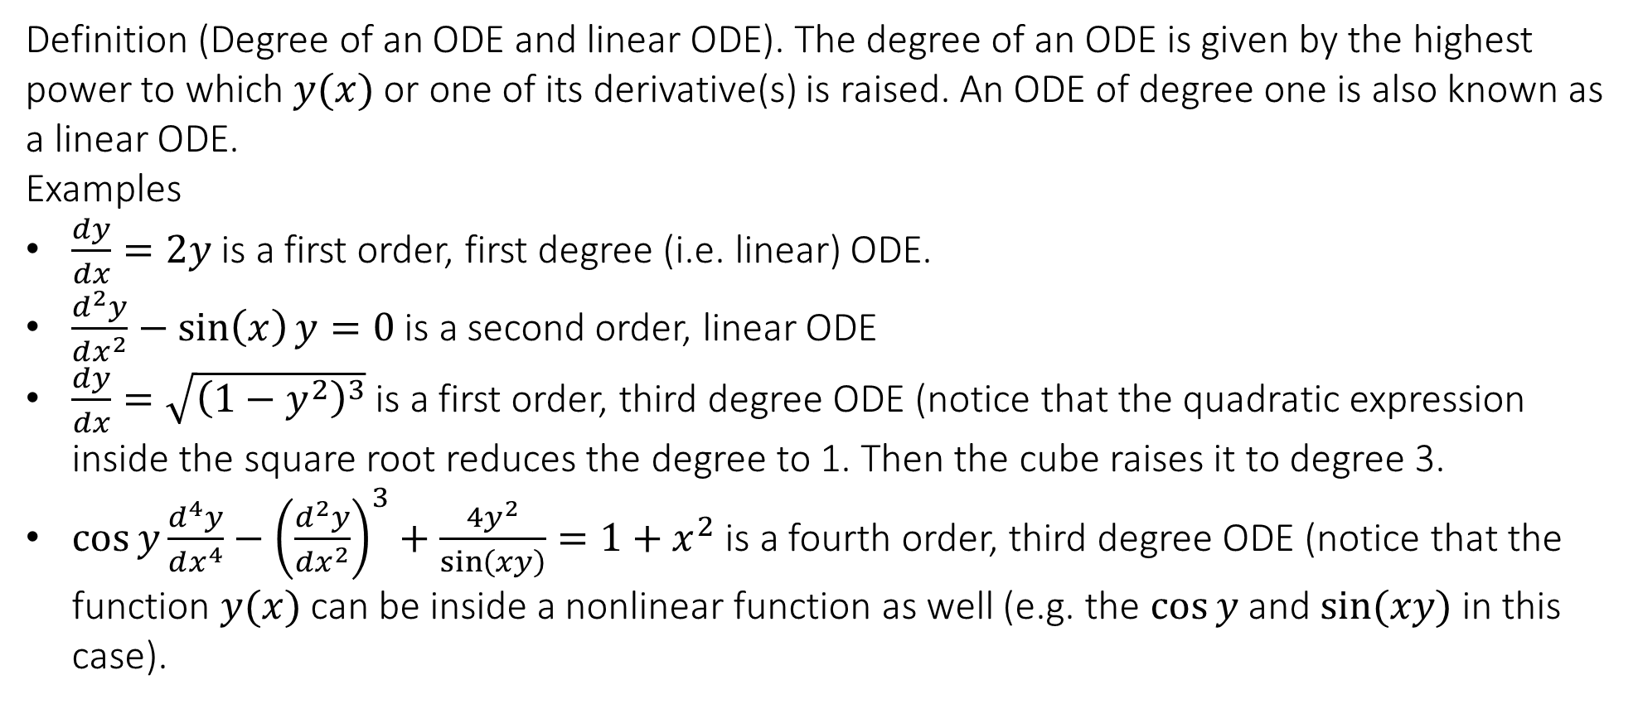
6.1 Differential Equations: definition, classification and solutions
Definition (Degree of an ODE and linear ODE). The degree of an ODE is given by the highest power to which $y(x)$ or one of its derivative(s) is raised. An ODE of degree one is also known as a linear ODE.
Examples
$\frac{dy}{dx}=2y$ is a first order, first degree (i.e. linear) ODE.
$\frac{d^{2}y}{dx^{2}}−\sin\left(x\right)y=0$ is a second order, linear ODE
$\frac{dy}{dx}=\sqrt{{\left(1−y^{2}\right)}^{3}}$ is a first order, third degree ODE (notice that the quadratic expression inside the square root reduces the degree to 1. Then the cube raises it to degree 3.
$\cos{y}\frac{d^{4}y}{dx^{4}}−{\left(\frac{d^{2}y}{dx^{2}}\right)}^{3}+\frac{4y^{2}}{\sin\left(xy\right)}=1+x^{2}$ is a fourth order, third degree ODE (notice that the function $y(x)$ can be inside a nonlinear function as well (e.g. the $\cos{y}$ and $\sin{(xy)}$ in this case).

Slide 16
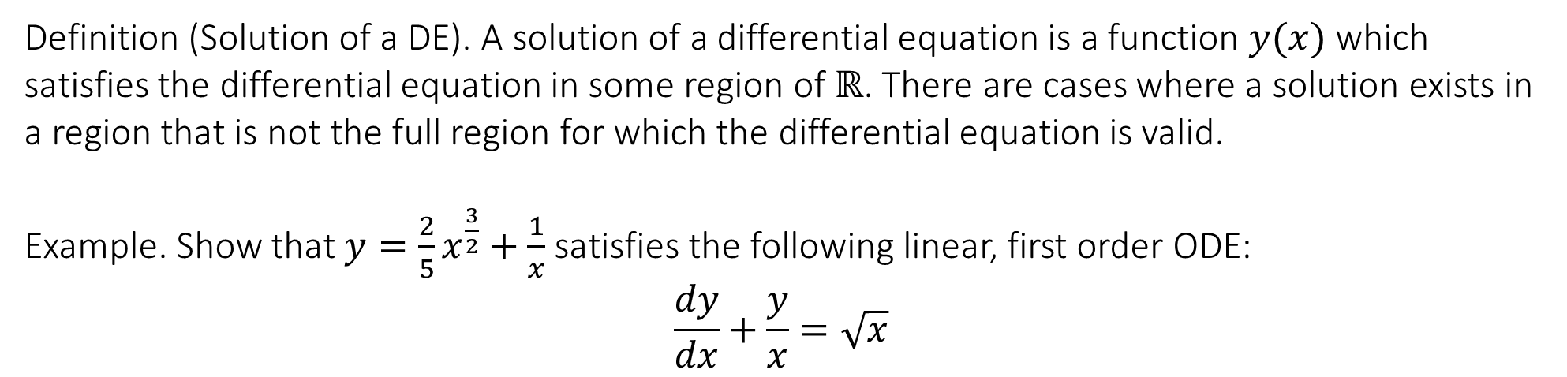
6.1 Differential Equations: definition, classification and solutions
Definition (Solution of a DE). A solution of a differential equation is a function $y(x)$ which satisfies the differential equation in some region of $ℝ$. There are cases where a solution exists in a region that is not the full region for which the differential equation is valid.
Example. Show that $y=\frac{2}{5}x^{\frac{3}{2}}+\frac{1}{x}$ satisfies the following linear, first order ODE:
$$\frac{dy}{dx}+\frac{y}{x}=\sqrt{x}$$

Slide 17
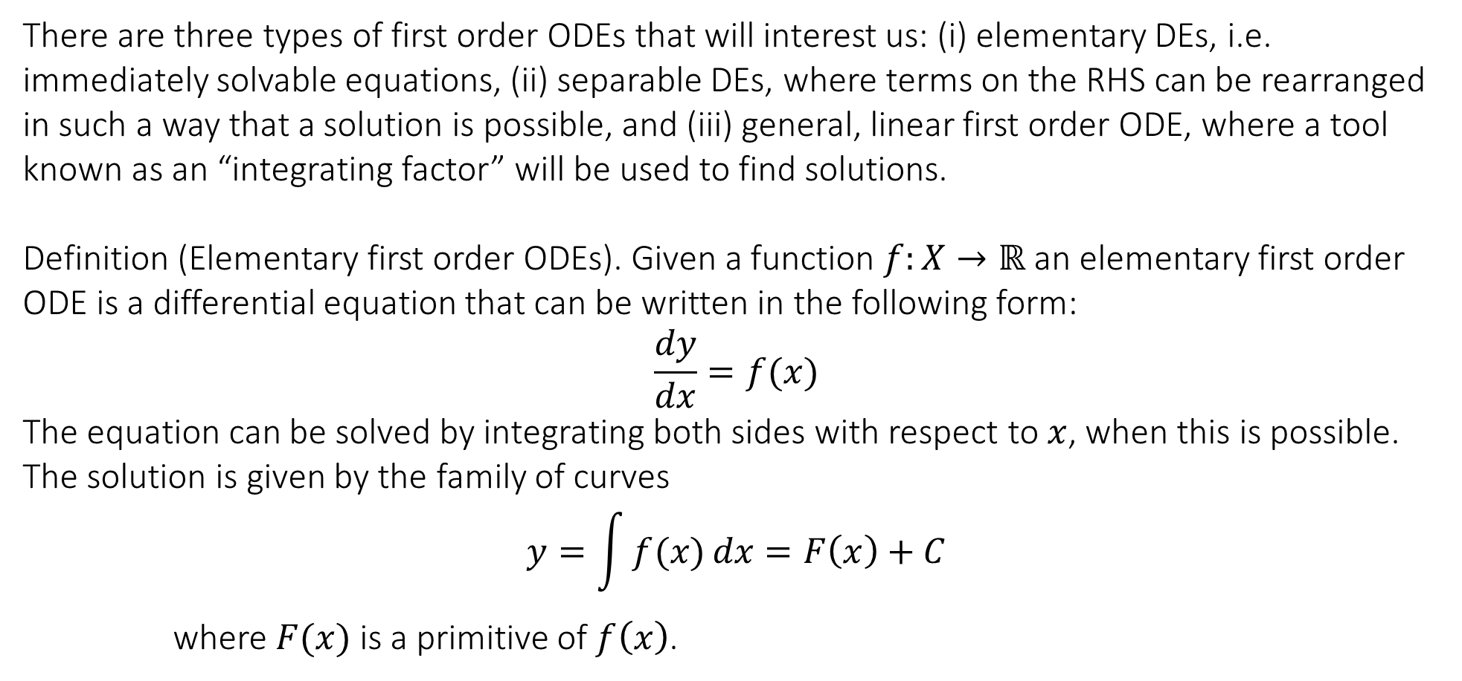
6.2 Elementary and separable first order ODE and initial value problems
There are three types of first order ODEs that will interest us: (i) elementary DEs, i.e. immediately solvable equations, (ii) separable DEs, where terms on the RHS can be rearranged in such a way that a solution is possible, and (iii) general, linear first order ODE, where a tool known as an “integrating factor” will be used to find solutions.
Definition (Elementary first order ODEs). Given a function $f:X→ℝ$ an elementary first order ODE is a differential equation that can be written in the following form:
$$\frac{dy}{dx}=f(x)$$
The equation can be solved by integrating both sides with respect to $x$, when this is possible. The solution is given by the family of curves
$$y=\int{f(x)}dx=F\left(x\right)+C$$
where $F(x)$ is a primitive of $f\left(x\right)$.

Slide 18
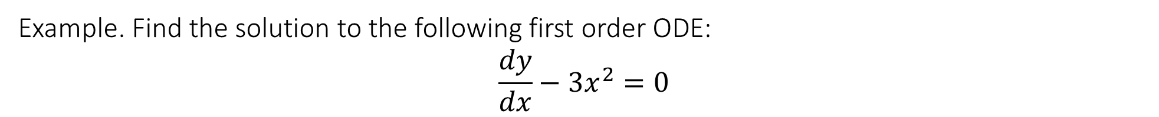
6.2 Elementary and separable first order ODE and initial value problems
Example. Find the solution to the following first order ODE:
$$\frac{dy}{dx}−3x^{2}=0$$

Slide 19
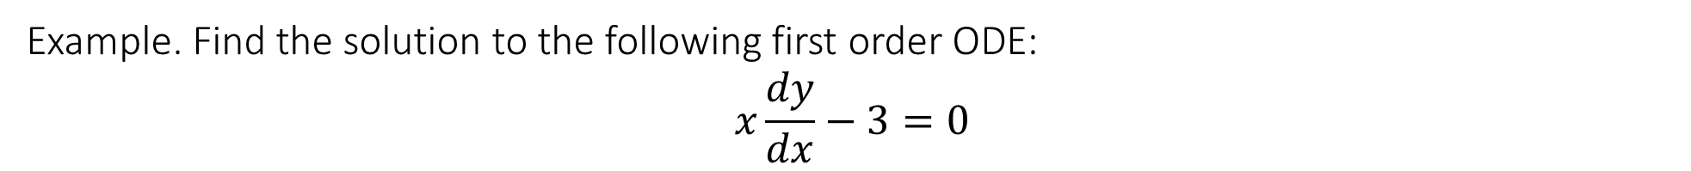
6.2 Elementary and separable first order ODE and initial value problems
Example. Find the solution to the following first order ODE:
$$x\frac{dy}{dx}−3=0$$

Slide 20
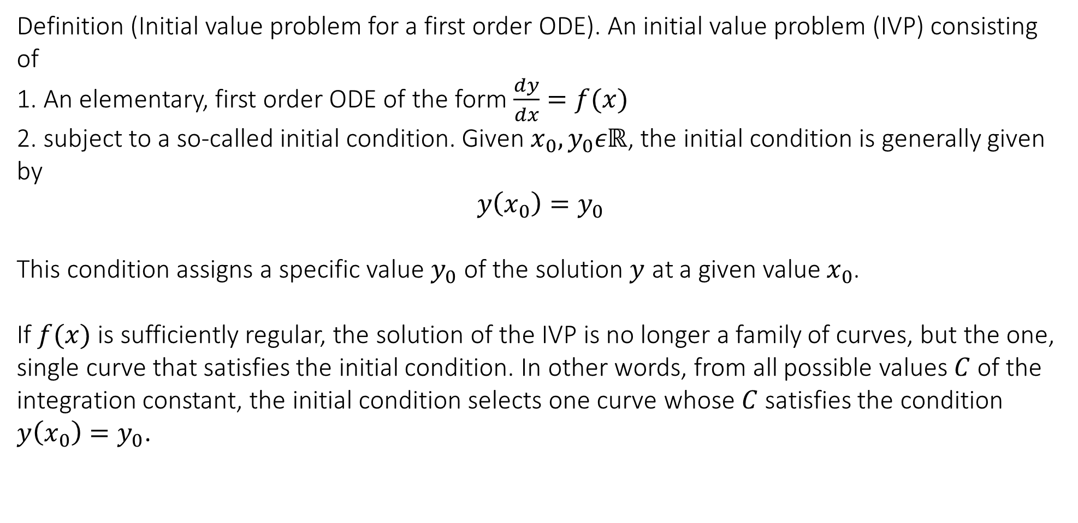
6.2 Elementary and separable first order ODE and initial value problems
Definition (Initial value problem for a first order ODE). An initial value problem (IVP) consisting of
1. An elementary, first order ODE of the form $\frac{dy}{dx}=f(x)$
2. subject to a so-called initial condition. Given $x_{0},y_{0}εℝ$, the initial condition is generally given by
$$y\left(x_{0}\right)=y_{0}$$
This condition assigns a specific value $y_{0}$ of the solution $y$ at a given value $x_{0}$.
If $f(x)$ is sufficiently regular, the solution of the IVP is no longer a family of curves, but the one, single curve that satisfies the initial condition. In other words, from all possible values $C$ of the integration constant, the initial condition selects one curve whose $C$ satisfies the condition $y\left(x_{0}\right)=y_{0}$.

Slide 21
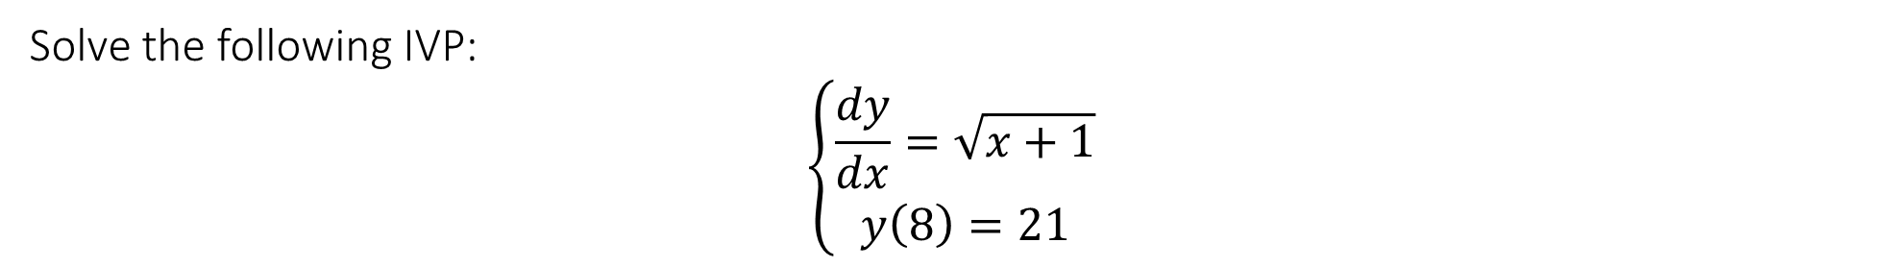
6.2 Elementary and separable first order ODE and initial value problems
Solve the following IVP:
$$\left\{\begin{matrix}\frac{dy}{dx}=\sqrt{x+1} \\ y\left(8\right)=21\end{matrix}\right.$$

Slide 22
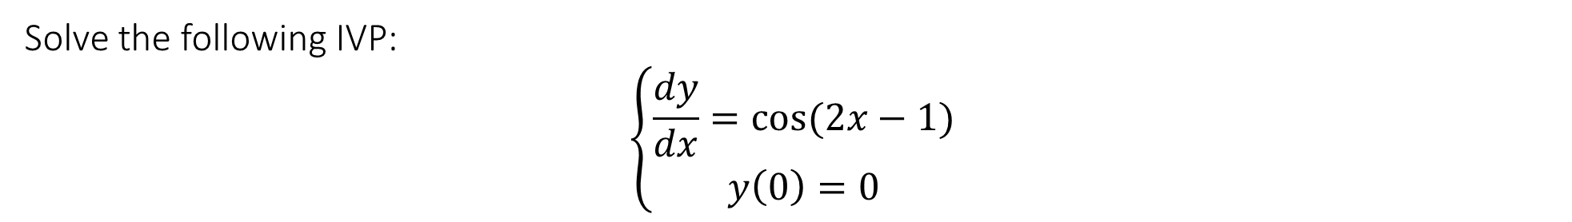
6.2 Elementary and separable first order ODE and initial value problems
Solve the following IVP:
$$\left\{\begin{matrix}\frac{dy}{dx}=cos⁡(2x−1) \\ y\left(0\right)=0\end{matrix}\right.$$

Slide 23
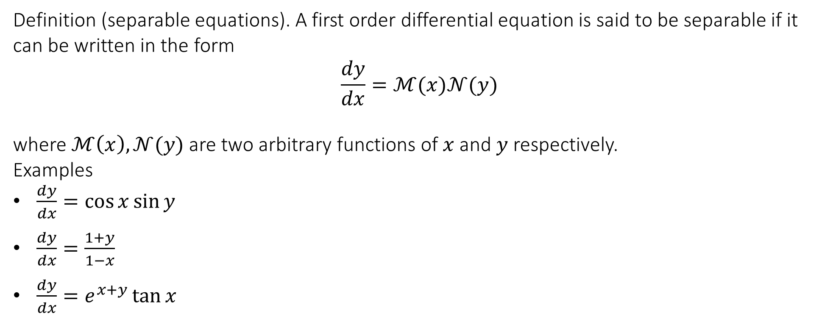
6.2 Elementary and separable first order ODE and initial value problems
Separable differential equations
Definition (separable equations). A first order differential equation is said to be separable if it can be written in the form
$$\frac{dy}{dx}=ℳ(x)𝒩(y)$$
where $ℳ\left(x\right), 𝒩(y)$ are two arbitrary functions of $x$ and $y$ respectively.
Examples
$\frac{dy}{dx}=\cos{x}\sin{y}$
$\frac{dy}{dx}=\frac{1+y}{1−x}$
$\frac{dy}{dx}=e^{x+y}\tan{x}$

Slide 24
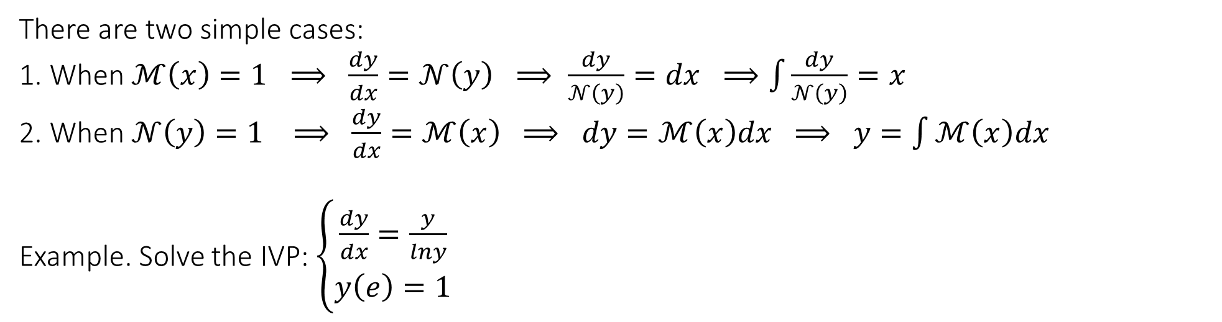
6.2 Elementary and separable first order ODE and initial value problems
There are two simple cases:
1. When $ℳ\left(x\right)=1 ⟹ \frac{dy}{dx}=𝒩\left(y\right) ⟹ \frac{dy}{𝒩\left(y\right)}=dx ⟹\int{\frac{dy}{𝒩\left(y\right)}}=x$
2. When $𝒩\left(y\right)=1 ⟹ \frac{dy}{dx}=ℳ\left(x\right) ⟹ dy=ℳ\left(x\right)dx ⟹ y=\int{ℳ\left(x\right)dx}$
Example. Solve the IVP: $\left\{\begin{matrix}\frac{dy}{dx}=\frac{y}{lny} \\ y\left(e\right)=1\end{matrix}\right.$

Slide 25

6.2 Elementary and separable first order ODE and initial value problems
Example. Solve the IVP: $\left\{\begin{matrix}\frac{dy}{dx}=\frac{y}{lny} \\ y\left(e\right)=1\end{matrix}\right.$

Slide 26
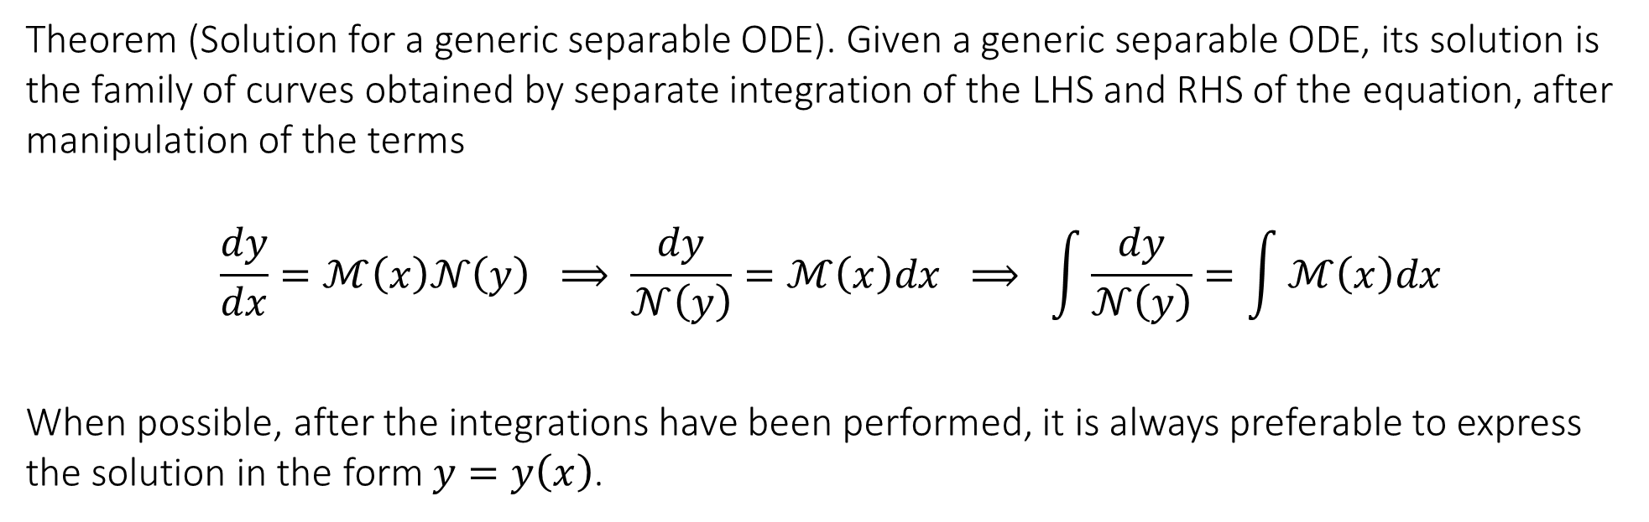
6.2 Elementary and separable first order ODE and initial value problems
Theorem (Solution for a generic separable ODE). Given a generic separable ODE, its solution is the family of curves obtained by separate integration of the LHS and RHS of the equation, after manipulation of the terms
$$\frac{dy}{dx}=ℳ\left(x\right)𝒩\left(y\right) ⟹ \frac{dy}{𝒩\left(y\right)}=ℳ\left(x\right)dx ⟹ \int{\frac{dy}{𝒩\left(y\right)}}=\int{ℳ\left(x\right)dx}$$
When possible, after the integrations have been performed, it is always preferable to express the solution in the form $y=y\left(x\right)$.

Slide 27
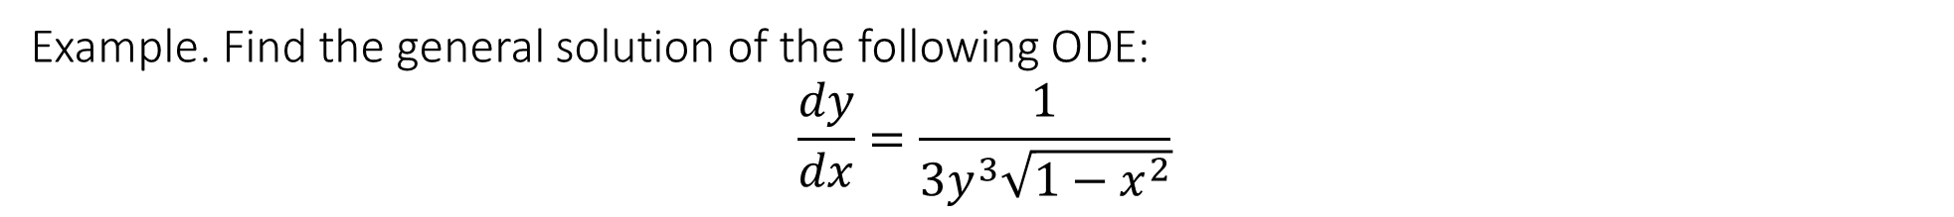
6.2 Elementary and separable first order ODE and initial value problems
Example. Find the general solution of the following ODE:
$$\frac{dy}{dx}=\frac{1}{3y^{3}\sqrt{1−x^{2}}}$$

Slide 28
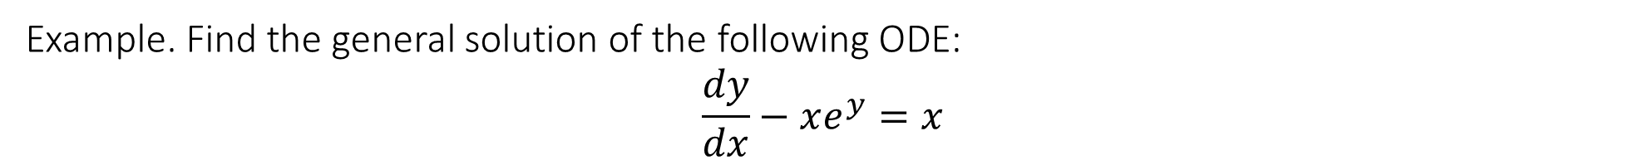
6.2 Elementary and separable first order ODE and initial value problems
Example. Find the general solution of the following ODE:
$$\frac{dy}{dx}−xe^{y}=x$$

Slide 29

6.2 Elementary and separable first order ODE and initial value problems
Example. Find the solution of the following IVP: $\left\{\begin{matrix}\frac{dy}{dx}=\frac{\sin{x}}{y\cos{y}} \\ y\left(0\right)=2π\end{matrix}\right.$

Slide 30
6.2 Elementary and separable first order ODE and initial value problems
Example. Find the general solution of the DE $\frac{1}{3x^{2}}\frac{dy}{dx}=2y−1$

Slide 31
End of Lecture

